Slide 1
Update 2
Dev Bhatia
Ultrafast Optics Laboratory
Boston University

Slide 2
Paper Analysis
Li, Xinyu, Jia Liu, Shanshan Liang, and Changsen Sun. "980-nm Infrared Laser Modulation of Sodium Channel Kinetics in a Neuron Cell Linearly Mediated by Photothermal Effect." Journal of Biomedical Optics 19, no. 10 (2014): 105002-105002.

Slide 3
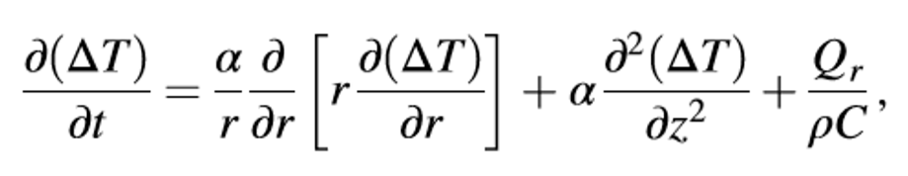
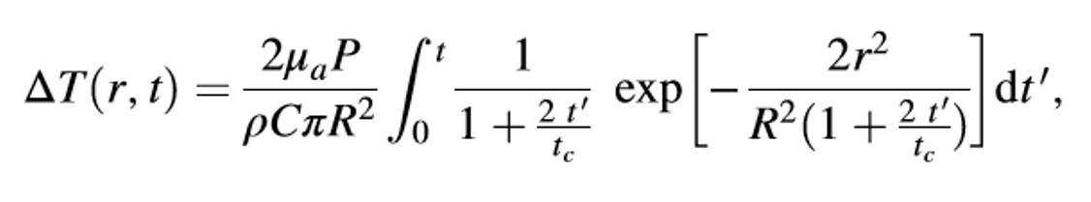
Theoretical Calculation of the ADTR
Eq. 1 –
Mathematical Model of Heat Conduction Equation
Eq. 2 –
Equation 1 solved using a Gaussian approximation. ΔT obtained in consideration of the thermal lens effect
The thermal lens effect occurs when the laser beam is absorbed in the focusing region
Equation 2 predicted a linear relationship between the laser power and ΔT.
This deduction was confirmed via an open pipette method to measure the ΔT directly
980-nm wavelength infrared laser irradiation

Slide 4
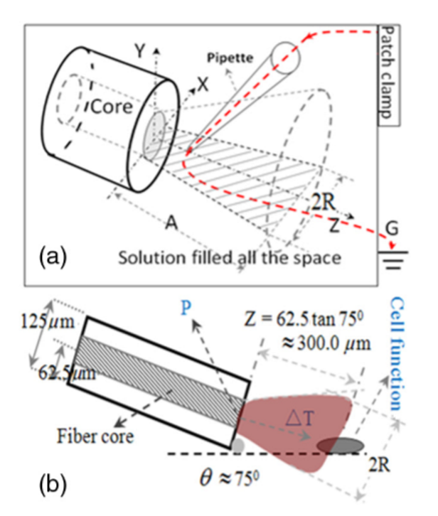
Open Pipette Method for ADTR Measurement
Rapid temperature measurement technique at the micron scale
Carried out by using a microamp current amplifier
Synchronized laser irradiation would cause a local temperature change
This would induce a resistance variation in the pipette
The measured pipette resistance was calibrated as a function of the ATR

Slide 5



Variable Considerations
μa = 73.9 cm^-1 Optical Absorption Coefficient
R = 93.41 μm Beam waist at axial distance
z = 164.56 μm Axial Distance
tc = .01523 s Characteristic time of the thermal lens
P = .009999 W irradiation laser power, obeys Beer-Lambert law with the initial laser power Po
κ = 0.6 W/mK thermal conductivity
ρ = 1000 kg/m^3 density of water
c = 4188 J kg^-1 K^-1 heat capacity
r = 25 μm radius of the fiber core
ρ = resistivity determined by the open pipette
γ = conductance of pipette
T = temperature
γo = solution conductance at To
αT = temperature coefficient of solution conductance

Slide 6
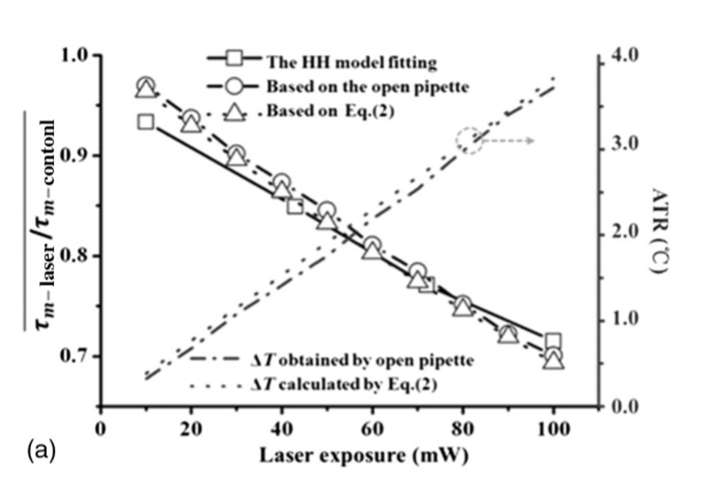
Results
A linear relationship between the scales of the infrared laser exposures and that of the absorption - driven temperature rises generation in the extracellular solution. This trend was predicted by the theoretical calculation of the ADTR.
Laser Parameters:
Laser duration = 500 ms
Fiber core radius = 5 μm

Slide 7
Paper Analysis
Yao, Jing, Beiying Liu, and Feng Qin. "Rapid Temperature Jump by Infrared Diode Laser Irradiation for Patch-Clamp Studies." Biophysical Journal 96, no. 9 (2009): 3611-619.

Slide 8
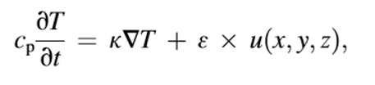
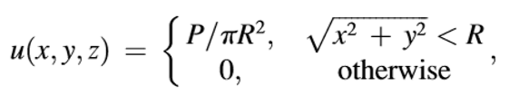
Theoretical Temperature Simulation
A collimated laser beam is assumed in order to approximate the power with a cylindrical geometry centered along the z-axis
The model ignores the loss of power of the beam due to water absorption (<3%) and temperature dependence of cp
Heat Conductance Equation
Spatial Distribution of Laser Power

Slide 9
Variable Considerations
cp = specific heat capacity of water
κ = thermal conductivity
ε = optical absorption coefficient
u = spatial distribution of laser power
P = total output power
R = Fiber Radius

Slide 10
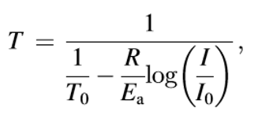
Experimental Calibration
Actual laser induced temperature changes are measured by monitoring current flowing through an open patch pipette
To calibrate the temperature from the current, the temperature dependence of electrode current was premeasured
Temperature calibrated from the pipette current

Slide 11
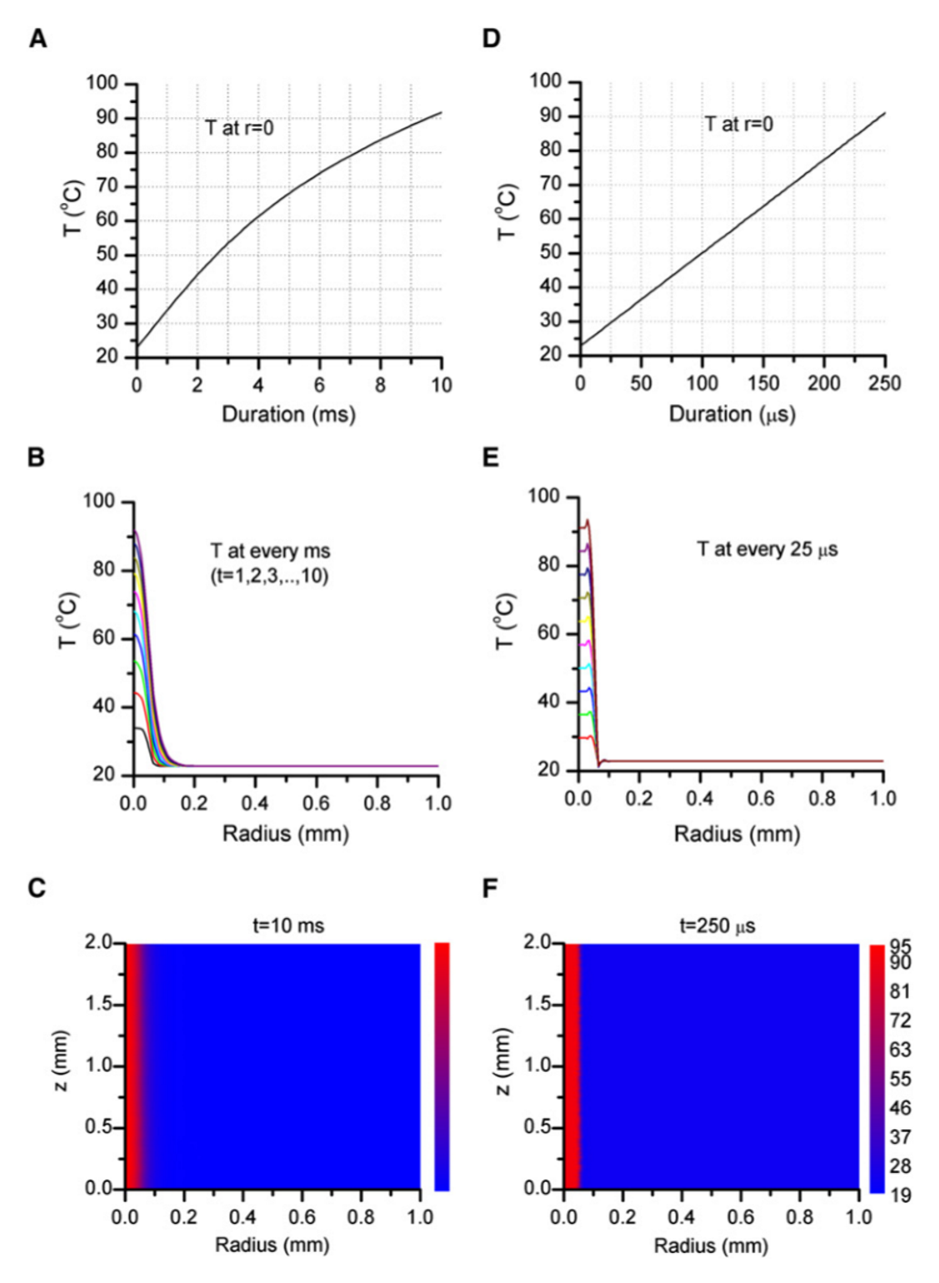
Simulation of laser-induced temp change
Beam of 8 W at 980 nm
Beam of 3 W at 1460 nm
**Both laser fibers assume a 100 μm diameter

Slide 12
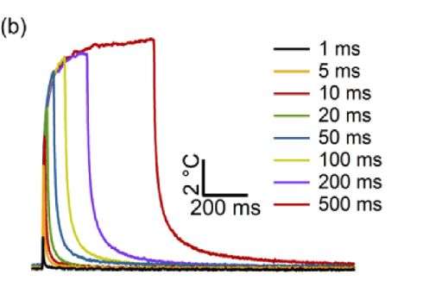
Conclusion
Given the experimental data, it can be seen that the beginning area is sublinear.
Taken from:
Zhu, Xuedong, Jen-Wei Lin, and Michelle Y Sander. "Infrared Inhibition and Waveform Modulation of Action Potentials in the Crayfish Motor Axon." Biomedical Optics Express 10, no. 12 (2019): 6580-6594.
Representative temperature transients

Slide 13
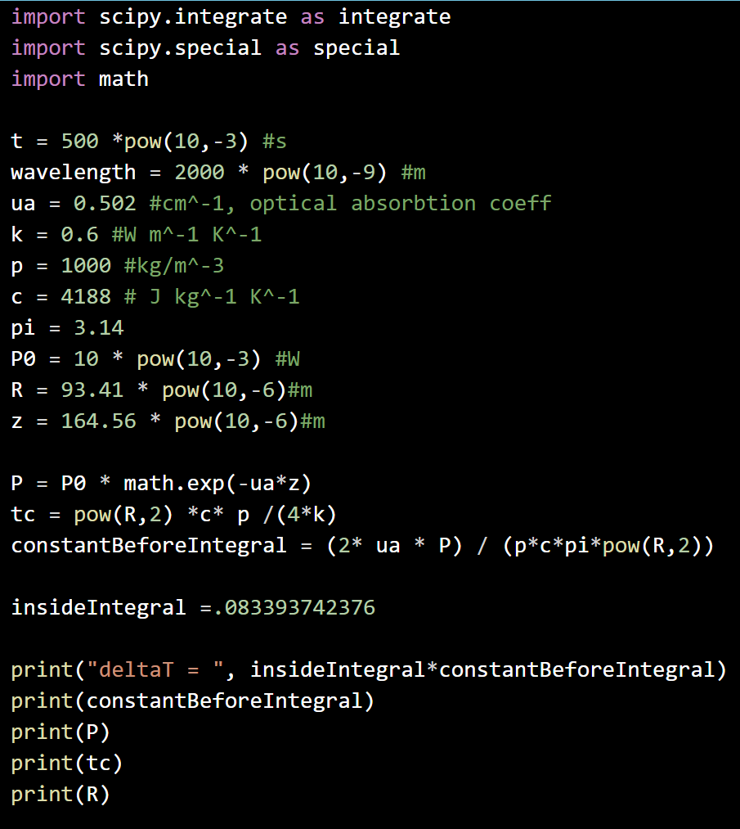
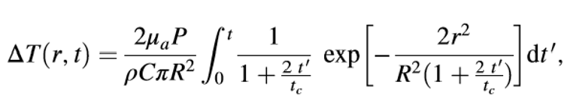
Implementation in Python
Absorption Driven Temperature Rise [3]

Slide 14
Next Steps
Implement second theoretical temperature simulation with our laser parameters
Deconstruct Vanderbilt code (repository found + cloned)
Fix first theoretical simulation

